Slide 1
TRAFFIC FORECASTING by capturing the continuity and periodicity of time series through Traffic transformer
GUIDE DETAILS STUDENT DETAILS
DR.M.VIJAYALAKSHMI Nallendiran, A P
Associate Professor MCA(SS) - 2019272026

Slide 2
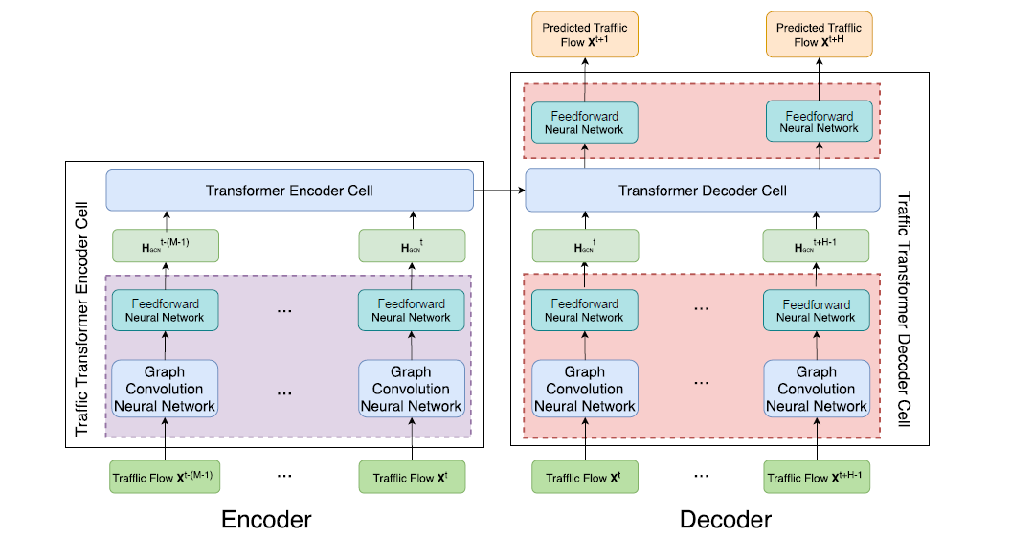
OVERALL ARCHITECTURE

Slide 3
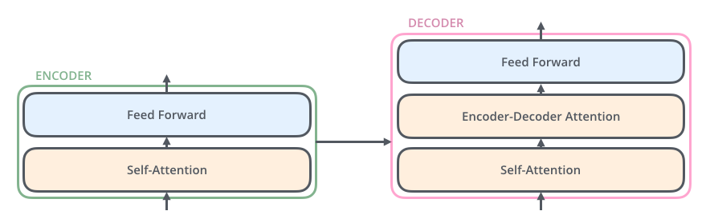

Slide 4
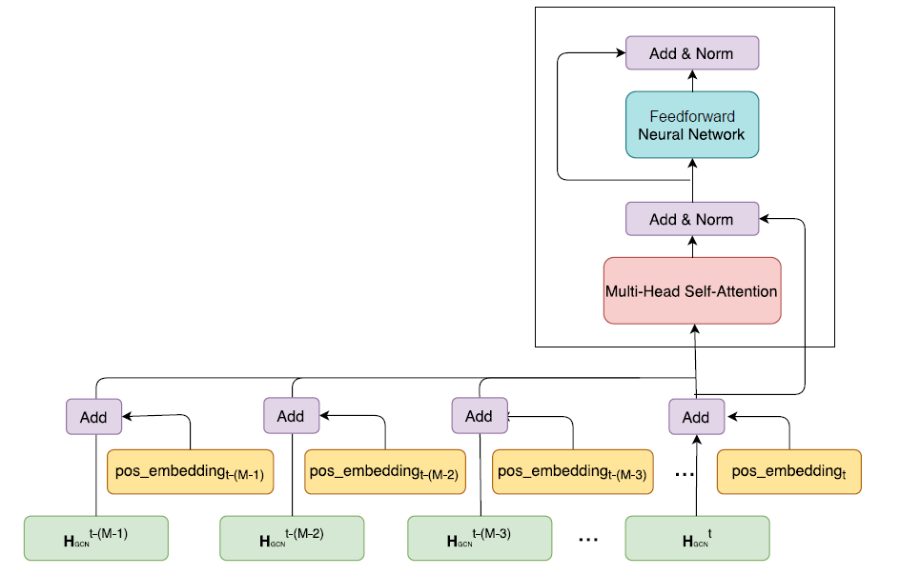

Slide 5
LIST OF MODULES
Import Modules
Video Pre-processing Format data for the model
Input Split
Model Training
Test Results
Validation

Slide 6
Video Preprocessing: Extracting key features from traffic footage using computer vision and OpenCV.
Main Components:
Background subtraction algorithms used for foreground detection.
OpenCV image filters.
Object detection by contours.
Building processing pipeline for further data manipulation.

Slide 7
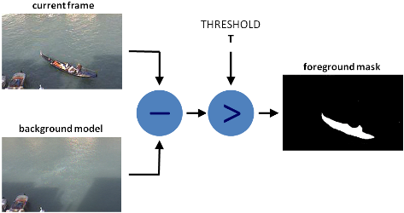
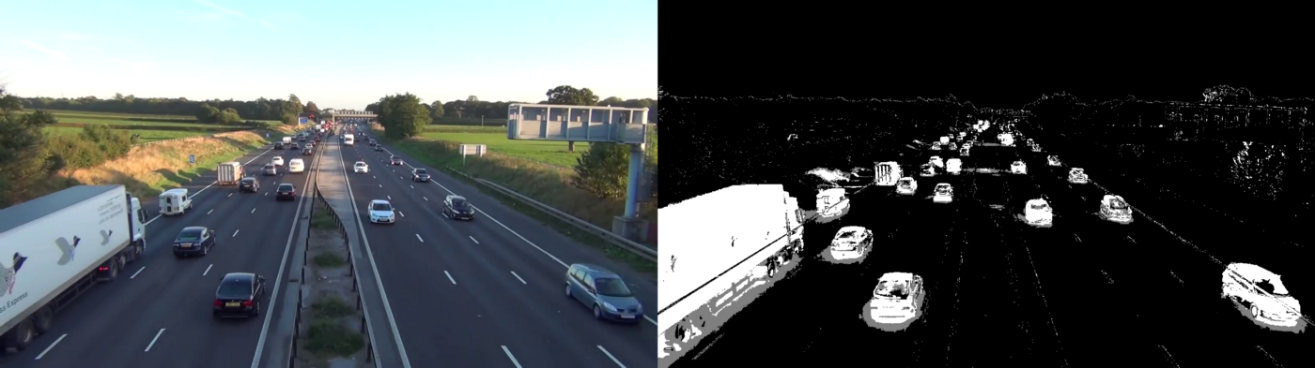
Background subtraction:

Slide 8
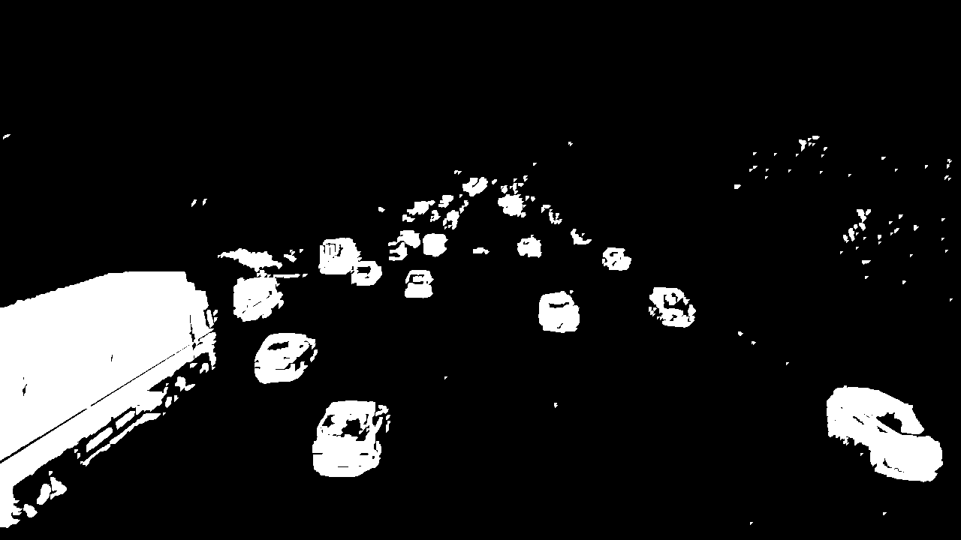
Filters Threshold, Erode, Dilate, Opening, Closing

Slide 9
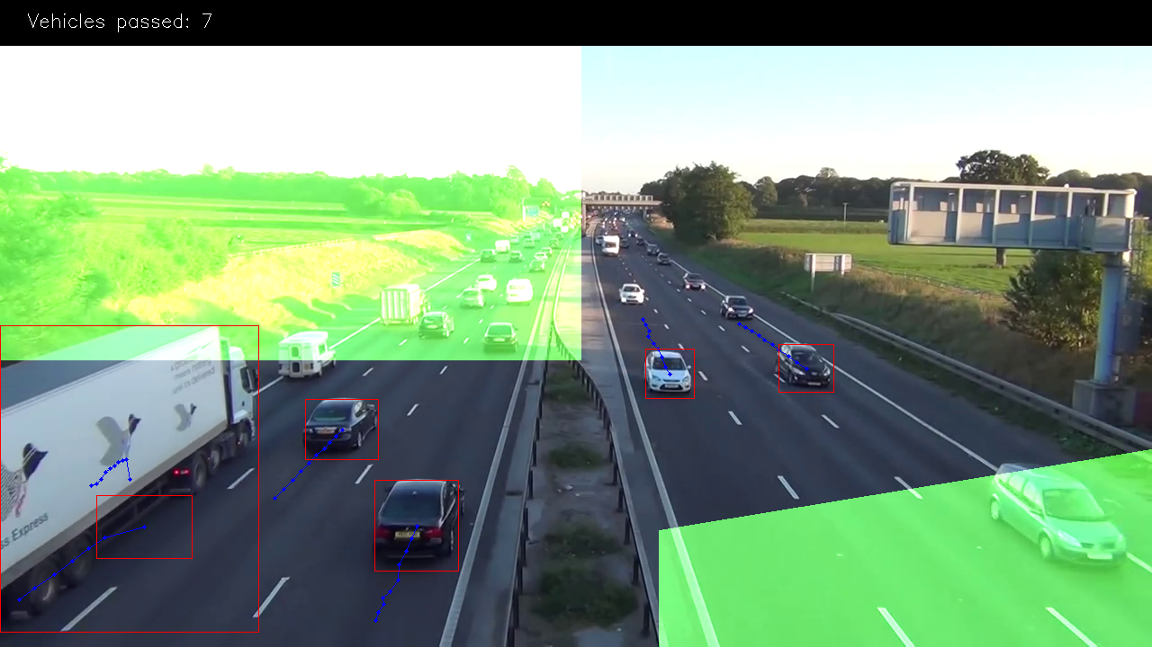
Object Detection & Building processing pipeline:

Slide 10
Modelling & Prediction
Main Components:
Importing Libraries
Loading Data
Data Exploration - Feature Engineering & EDA
Data Transformation and Preprocessing
Model Building
Fitting the Model
Inversing the Transformation of Data

Slide 11
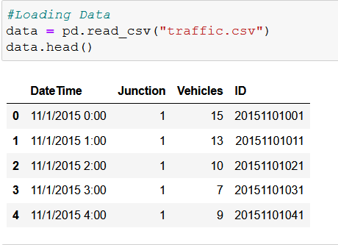
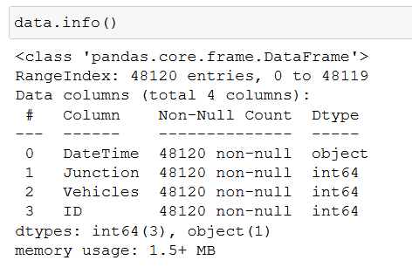
Loading Data:

Slide 12
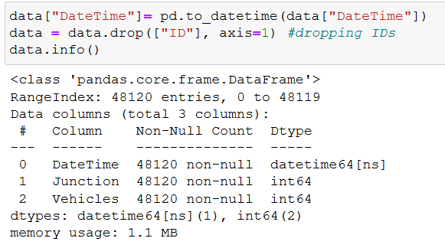
Data Exploration: Pharsing dates, Ploting timeseris, Feature engineering for EDA

Slide 13
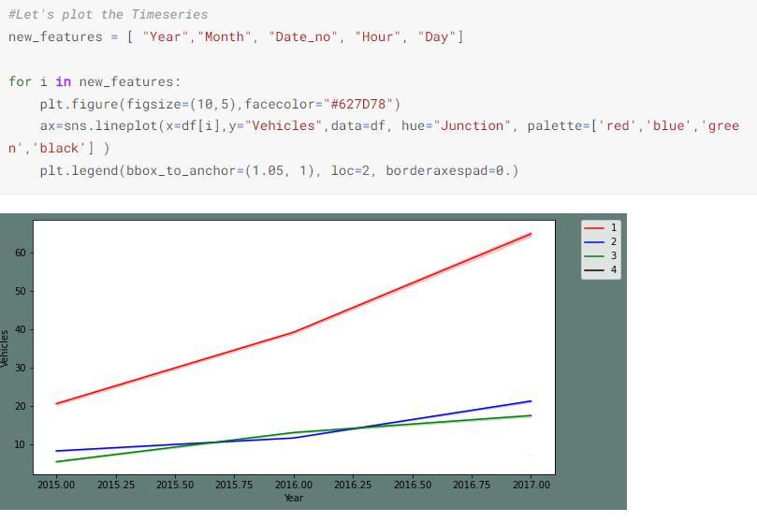

Slide 14
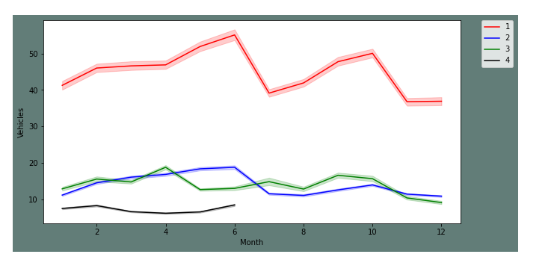
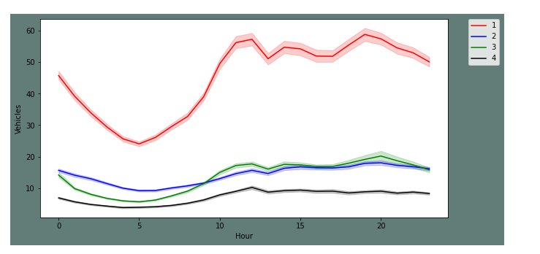

Slide 15
Data Transformation And Preprocessing:
Creating different frames for each Junction and plotting them.
Transforming the series and plotting them.
To check the seasonality of transformed series.
Creating test and train sets

Slide 16
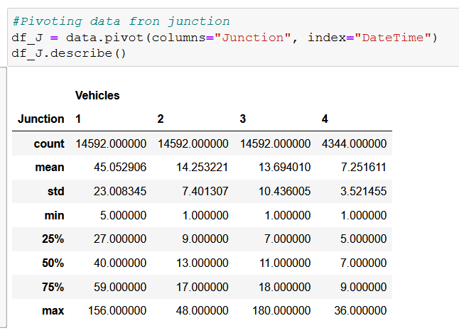
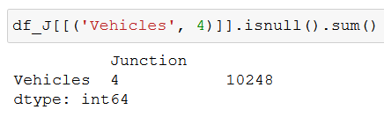

Slide 17
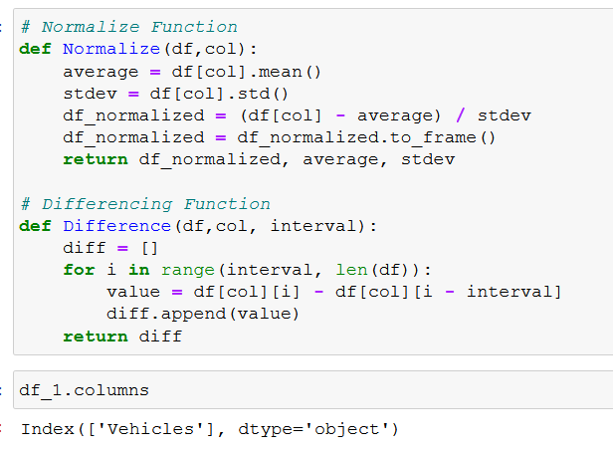
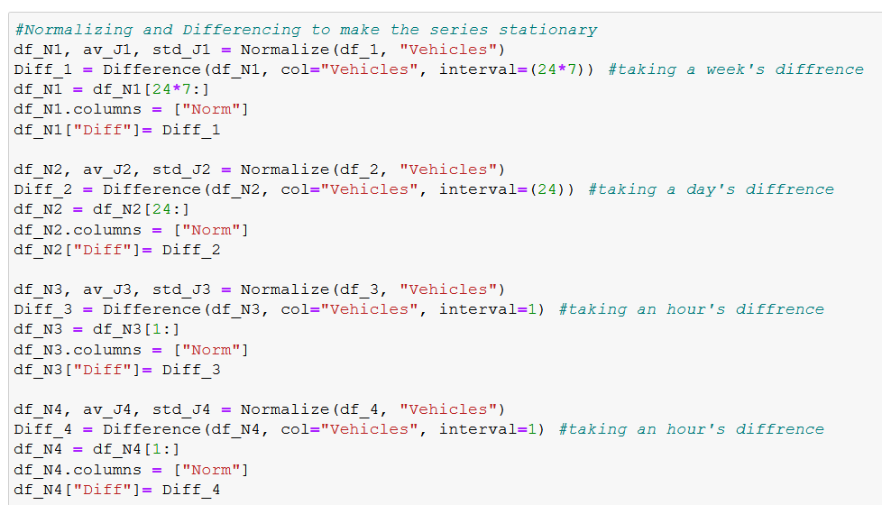
Transforming:
Normalizing
Differencing

Slide 18
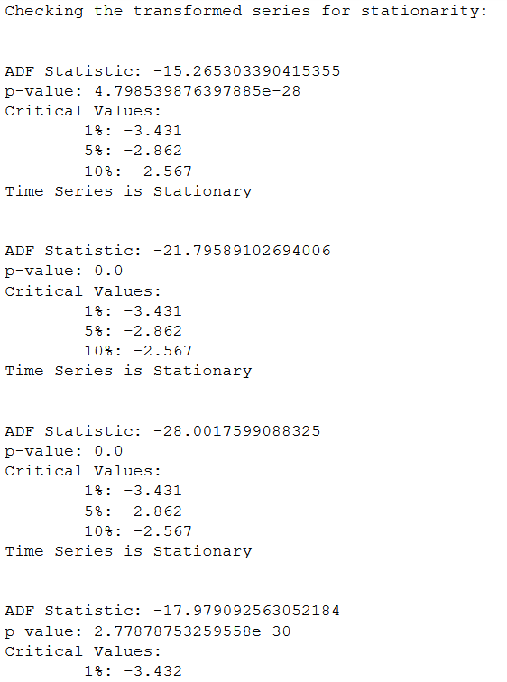
Transformed series for stationarity:

Slide 19
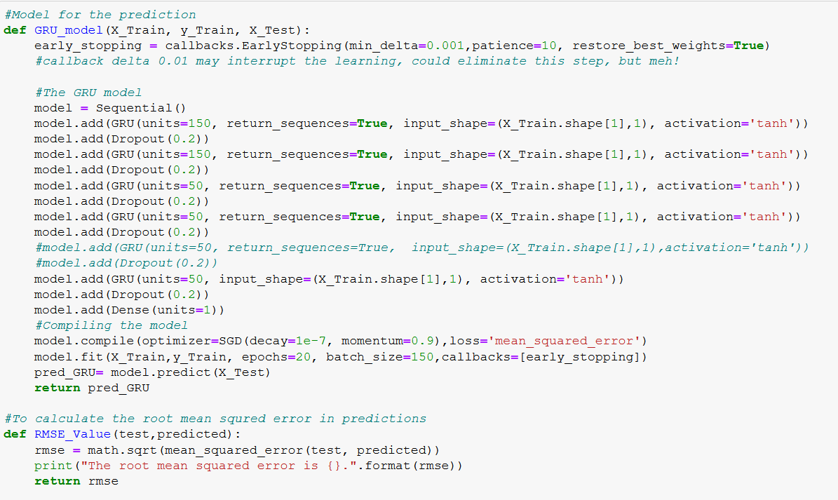
Model Building:

Slide 20
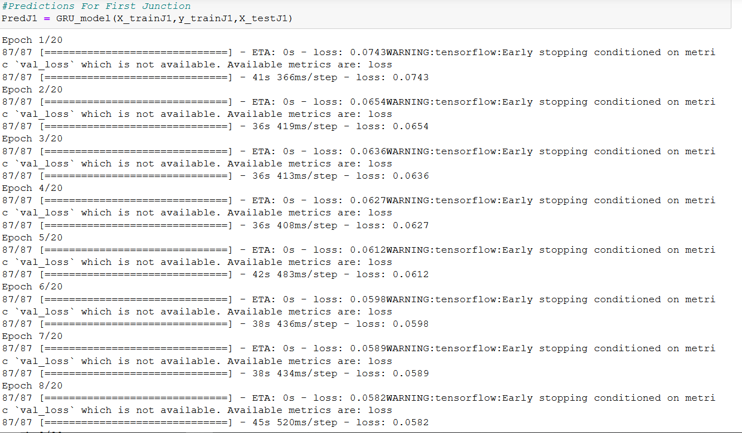
Fitting the Model:

Slide 21
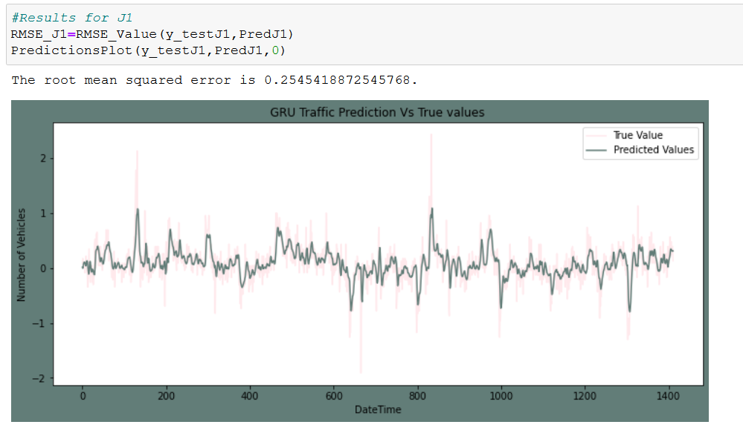
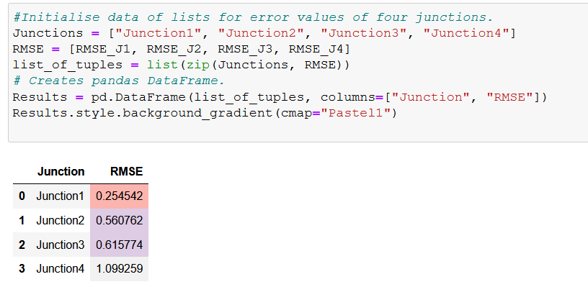
Results for Junction:

Slide 22
Results for Model:

Slide 23
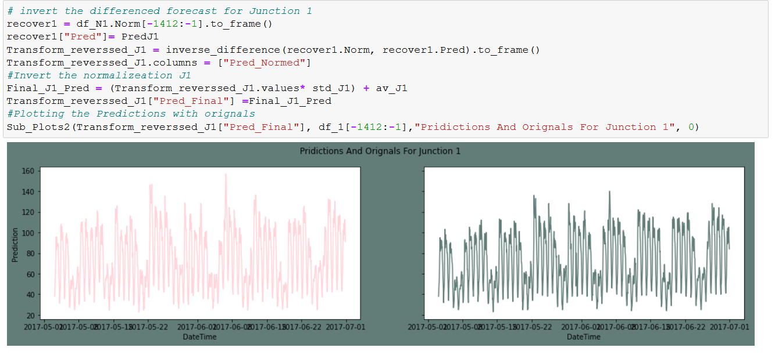
Inverse Transform:

